Slide 1

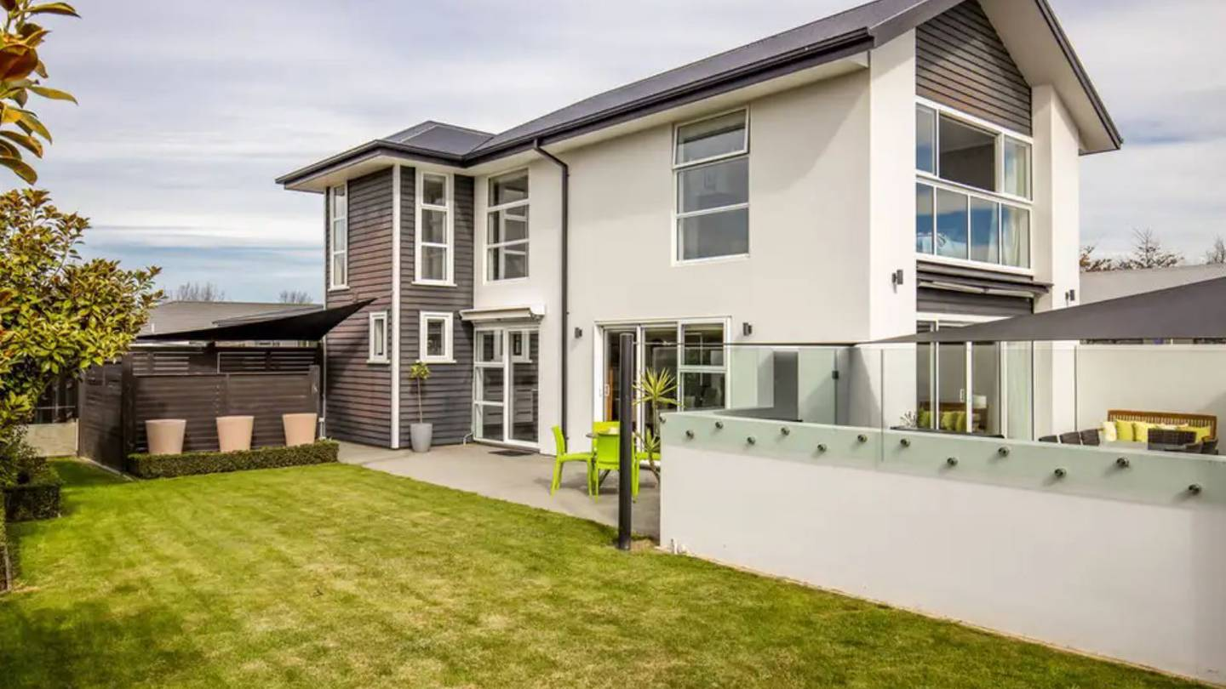
Presentation On
Housing: Price Prediction
Presented By: Ravi Kr. Sharma

Slide 2
Agenda
Introduction
Problem Statement
Problem Understanding
What Is Housing Price Prediction?
Importance of Housing Price Prediction
Benefits of Housing Price Prediction
Data Analysis & Modelling Flowchart
Exploratory Data Analysis
Visualizations
Data Analysis Steps Done
Assumptions
Model Building
Hyper Parameter Tuning
Saving the model and prediction results
Conclusion

Slide 3
INTRODUCTION
Thousands of houses are sold every day. There are some questions every buyer asks himself like: What is the actual price that this house deserves? Am I paying a fair price? Also Is it the location? Is it the overall quality of the house? Is it the size? Could it be sold at a good price in future? All these questions come in to our mind when we decide to purchase a house.
In this study, a machine learning model is proposed to predict a house price based on data related to the house (its size, the year it was built in, etc.). During the development and evaluation of our model, we will show the code used for each step followed by its output. This will facilitate the reproducibility of our work.

Slide 4
Problem Statement
A US-based housing company named Surprise Housing has decided to enter the Australian market. The company uses data analytics to purchase houses at a price below their actual values and flip them at a higher price. For the same purpose, the company has collected a data set from the sale of houses in Australia.
The company is looking at prospective properties to buy houses to enter the market. You are required to build a model using Machine Learning in order to predict the actual value of the prospective properties and decide whether to invest in them or not. For this company wants to know:
Which variables are important to predict the price of variable?
How do these variables describe the price of the house?

Slide 5
Problem Understanding
House prices increase every year. House prices trends are not only the concerns for buyers and sellers, but they also indicate the current economic situations. Therefore, it is important to predict the house prices without bias to help both buyers and sellers make their decisions.
So, there is a need for a system to predict house prices in the future. House price prediction can help the developer determine the selling price of a house and can help the customer to arrange the right time to purchase a house.
In real estate the value of property usually increases with time as seen in many countries. One of the causes for this is due to rising population. The value of property depends on the proximity of the property, its size its neighbourhood and audience for which the property is subjected to be sold. So machine learning models helps buyers and sellers to understand the house price of particular time.

Slide 6
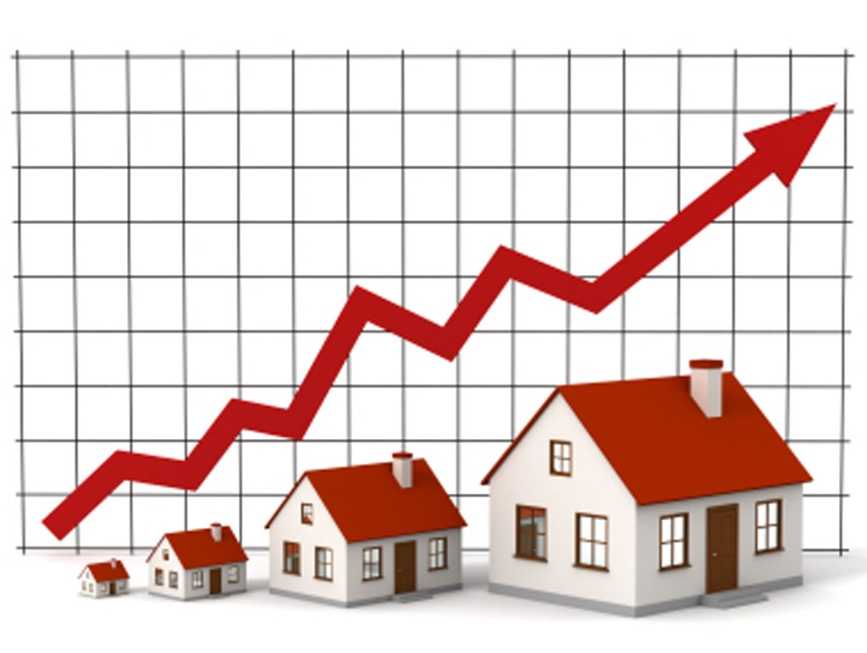
What is Housing Price Prediction?
The relationship between house prices and the economy is an important motivating factor for predicting house prices.The house price prediction helps the people to understand and know about the future price of the house.

Slide 7

Importance of Housing Price Prediction
House Price prediction, is important to drive Real Estate efficiency. As earlier, House prices were determined by calculating the acquiring and selling price in a locality. Therefore, the House Price prediction model is very essential in filling the information gap and improve Real Estate efficiency.
Prediction house prices are expected to help people who plan to buy a house so they can know the price range in the future, then they can plan their finance well.

Slide 8

Benefits of Housing Price Prediction
Predicting house prices can help to determine the selling price of a house of a particular region and can help people to find the right time to buy a home
An increase in prices may lead to an improvement in the consumer confidence of home-owners which might then cause a rise in consumer spending.
Householders can take equity withdrawal from the increased value of their house. For example, by re-mortgaging their property and releasing some of the housing equity.

Slide 9
Data Analysis and Model Building Flowchart
Import Libraries
Import Datasets
(Train & Test)
Data Preprocessing
Identifying Outliers and Skewness
Visualizations
(EDA)
Finding and Treating Null Values
Checking Correlation & VIF
Model Building
Ordinal Encoding
Saving the Model & Prediction
Hyper Parameter Tuning
R2 score, CV & evaluation metrics

Slide 10
Exploratory Data Analysis (EDA) Steps
Firstly, I have imported the necessary libraries and imported both train and test datasets which were in csv format. And process both datasets simultaneously.
I have done some statistical analysis like checking shape, nunique, column names, data types of the features, info about the features, value counts etc.
I have dropped “Id” and “Utilities” columns from both the datasets. Since they had no significance impact on the prediction.
While looking into the value count function I found some of the columns having more than 85% of zero values so, I dropped those columns from both the datasets as they might create skewness which will impact my model.

Slide 11
Exploratory Data Analysis (EDA) Steps
I have done some feature extraction as the datasets contained some time variables like YearBuilt, YearRemodAdd, GarageYrBlt and YrSold. Converting them into age seem more meaningful as they offer more information about the longevity of the features. It is analogous to the fact that, the statement “Mr. X died at the age of 66 years” holds more information for us than the statement “Mr. X died in the year 2019”. So, I have extracted age information from the datetime variables by taking the difference in year between the year the house was built and year the house was sold and dropped the year columns.
I checked the null values and found them in some of the columns. So, I imputed null values present in categorical and numerical columns using mode and mean methods respectively. I found some columns having more than 80% of null values so, I dropped those columns to overcome with the skewness.
All these steps were performed to both train and test datasets simultaneously.
To visualize the data, I have separated categorical and numerical variables based on their types. That is categorical types as Nominal and Ordinal, numerical types as Continuous and Discrete.

Slide 12
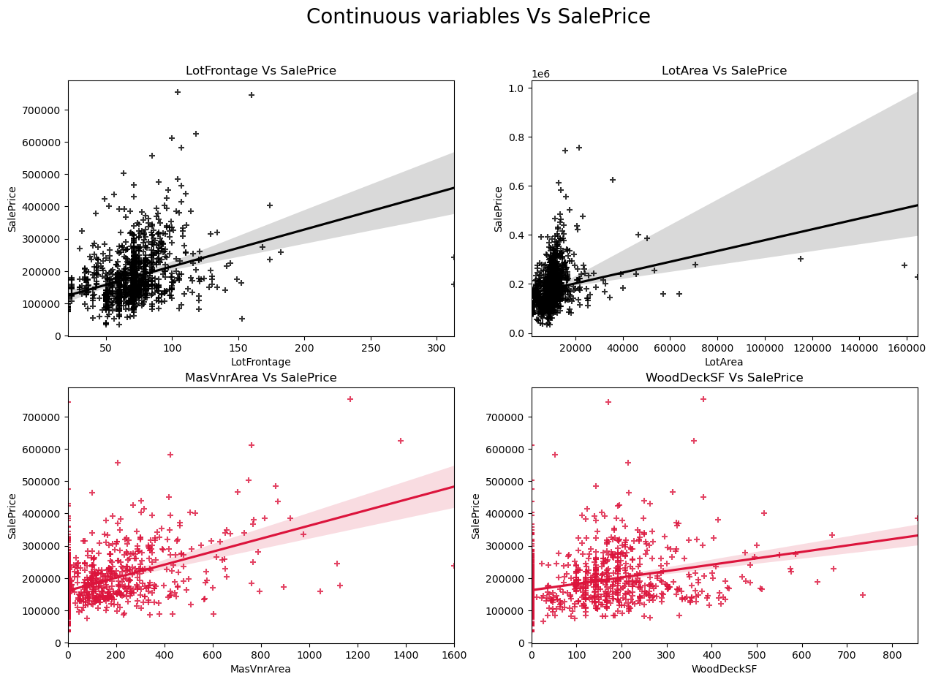
Visualizing Continuous Variables vs Sale Price

Slide 13
Observations from the above graphs:
SalePrice vs LotFrontage: From the plot we can observe there is no much linear relation between the label and feature. If the linear feet of street connected to property is more, the sale price is also high.
SalePrice vs LotArea: There is weakly positive linear relation between the label and feature. But the sale price is high when lot size has around 20000 square feet area. Also as the lot size increases the price is also increasing moderately.
SalePrice vs MasVnrArea: There is bit positive linear relation between feature and target. Also the sale price is high when Masonry veneer area has around 50-400 square feet. So as the Masonry veneer area in square feet increases sale price is also increasing.
SalePrice vs WoodDeckSF: There is weakly positive linear relation between the feature and target. As the Wood deck area increases, sale price is also increases.

Slide 14
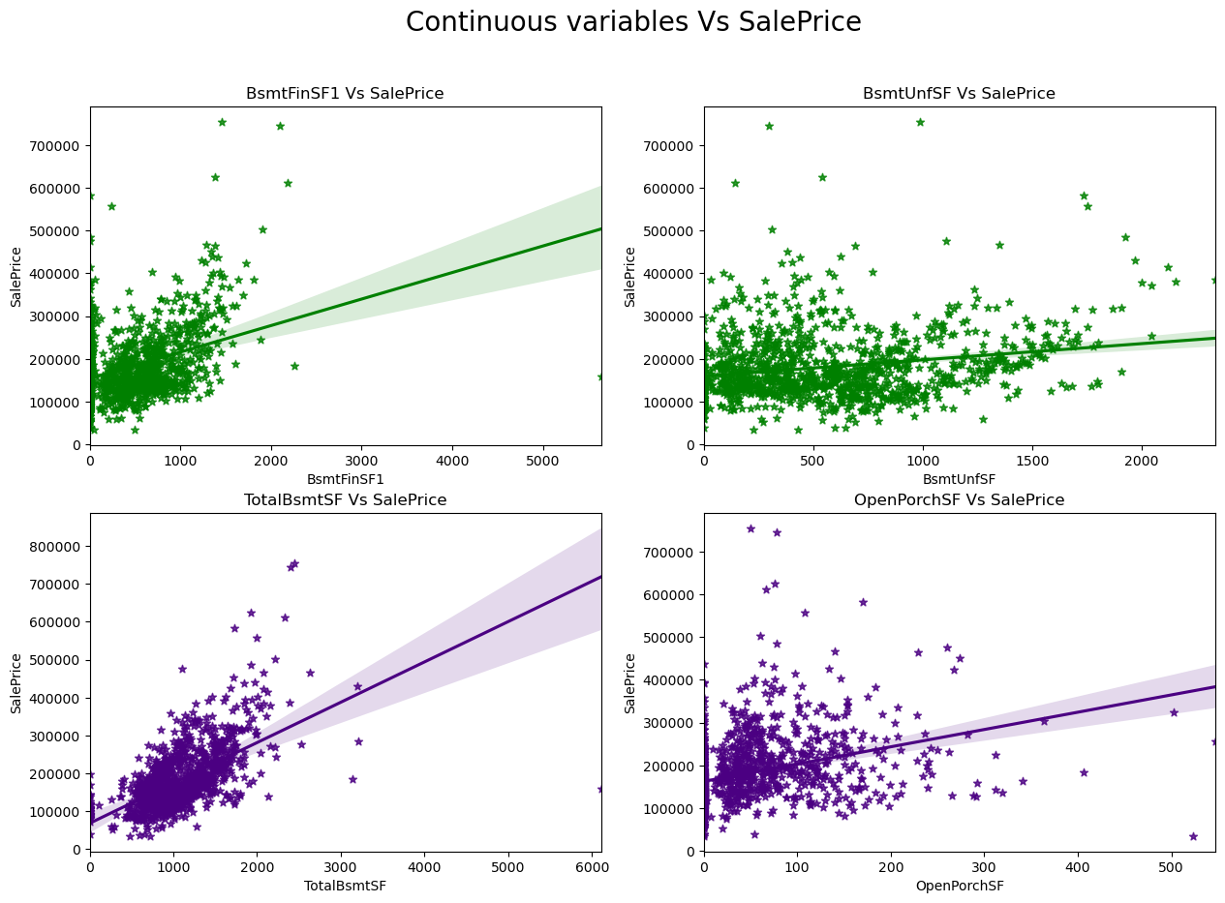
Visualizing Continuous Variables vs Sale Price

Slide 15
Observations:
SalePrice vs BsmtFinSF1: There is weakly positive linear relation between feature and label. The sale price is high that is 100000-300000 when basement square feet lie upto 1500 square feet. So as the type 1 basement finished square feet increases, sale price is also increases.
SalePrice vs BsmtUnfSF: There is positive linear relation between the target and BsmtUnfSF. When the unfinished basement area is below 1000 square feet, the sale price is high.
SalePrice vs TotalBsmtSF: There is positive linear relation between sale price nad TotalBsmtSF. As total basement area increases, sale price also increases.
SalePrice vs OpenPorchSF: There is a linear relation between the label and feature. The sale price is high when Open porch area is below 200 sf. Here also as the Open porch area increases, sale price is also increases.

Slide 16
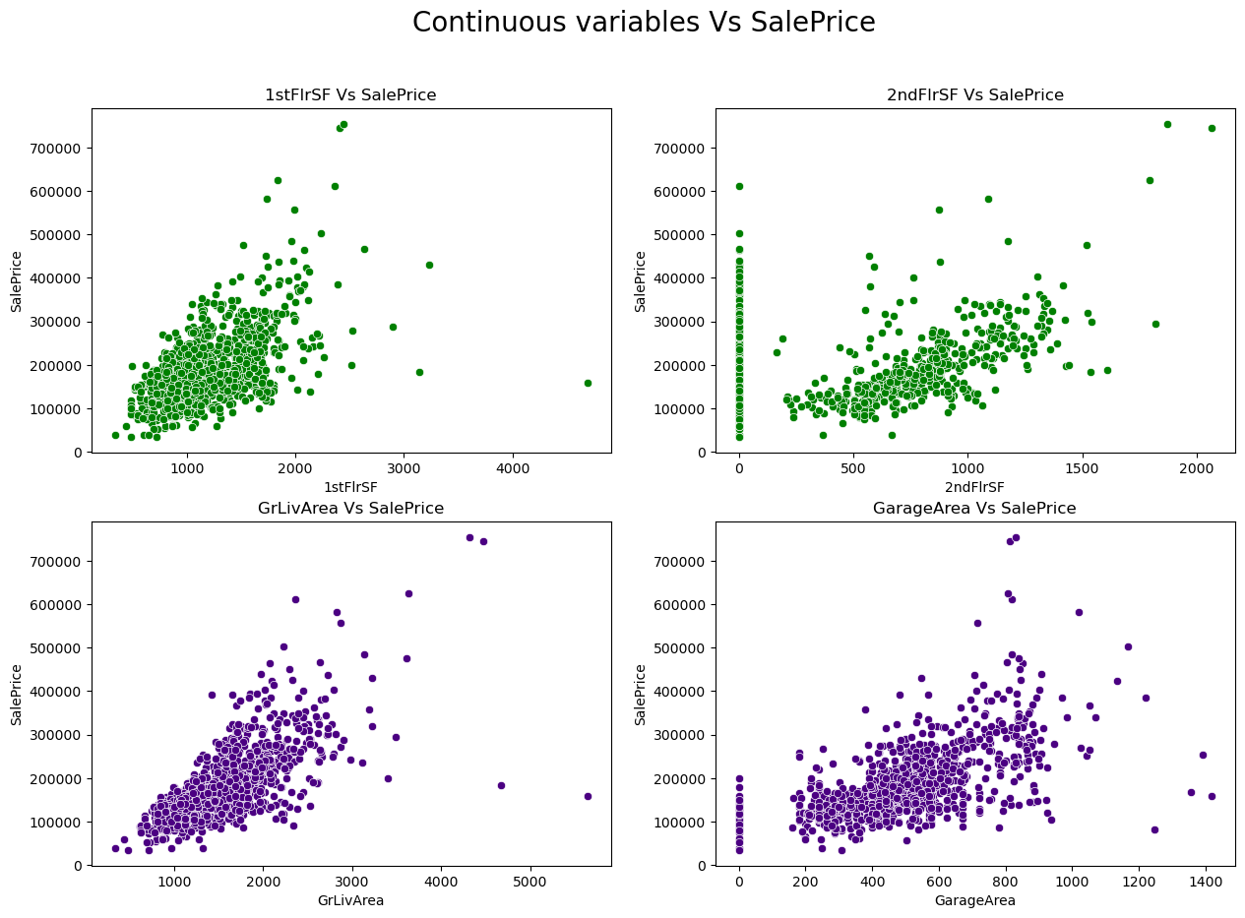
Visualizing Continuous Variables vs Sale Price

Slide 17
Observations:
SalePrice vs 1stFlrSF: There is a linear relation between the label and feature. As we can observe in the plot, the sale price is high when the first floor area lies between 500-2000 square feet. So as the 1st floor area increases, sales price also increases moderately.
SalePrice vs 2ndFlrSF: There is a positive correlation between SalePrice and 2ndFlrSF. So it is obvious that the sale price increases based on the floors.
SalePrice vs GrLivArea: Most of the houses have above grade living area. There is a positive correlation between the label and feature. Here as the above grade living area increases, sale price also increases.
SalePrice vs GarageArea: Similar to 2nd floor sf, here also positive linear relation between the label and feature. As size of garage area increases, sale price also increases. The sale price is high when size of garage area is beween 200-800 square feet.

Slide 18
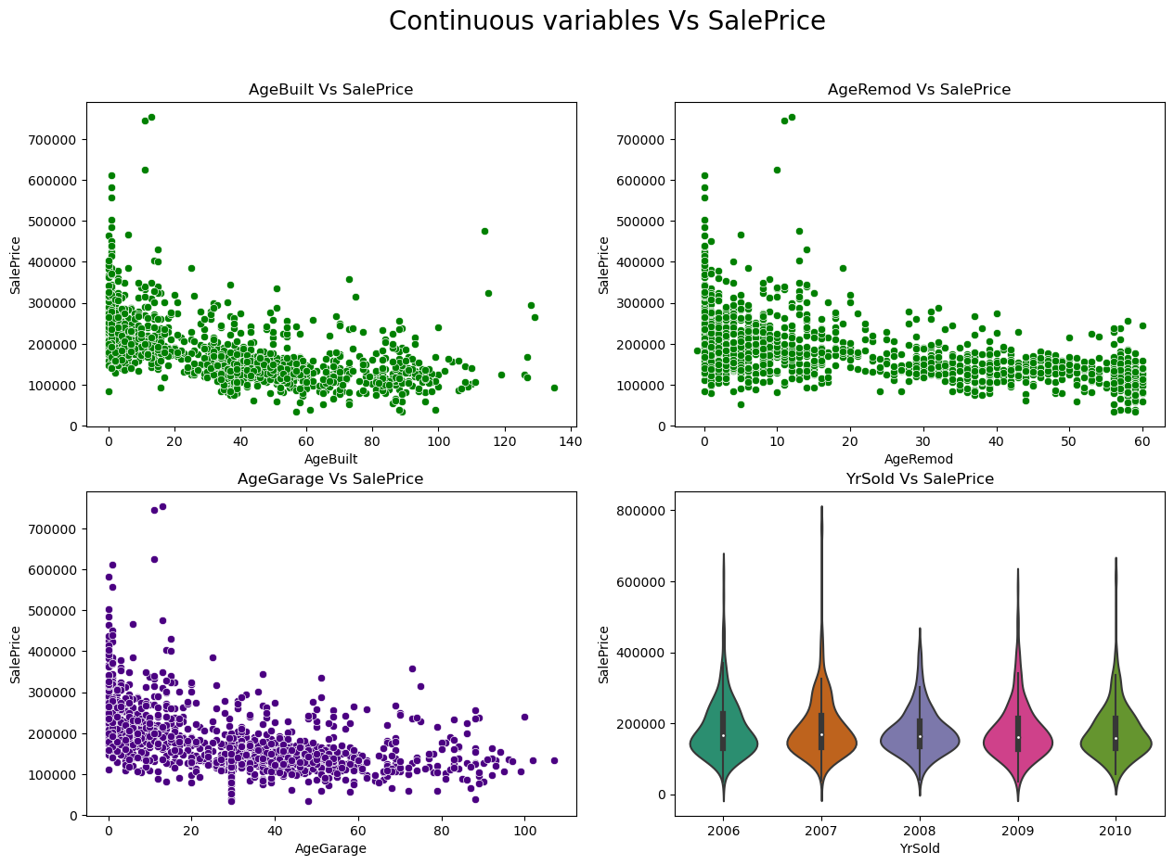
Visualizing Continuous Variables vs Sale Price

Slide 19
Observations:
SalePrice vs AgeBuilt: From the plot I can notice there is negative linear relation between sale price and AgeBuilt. The buildings which have built long back are having less sales price compare to new buildings. Also, there are presence of outliers in the data.
SalePrice vs AgeRemod: Similar to AgeBuilt, there is a negative linear relation between the label and features. As if Building modification has done long back then the price is less compared to new one. As the age increases, sale price decreases.
SalePrice vs AgeGarage: There is negative linear relation and houses which are having recently built garages, they have high sale price. As the age of the garage was built increases, the sale price decreases.
SalePrice vs YrSold: Almost all the buildings sold in the recent years and all of them have same sale price. There is no significance difference.

Slide 20
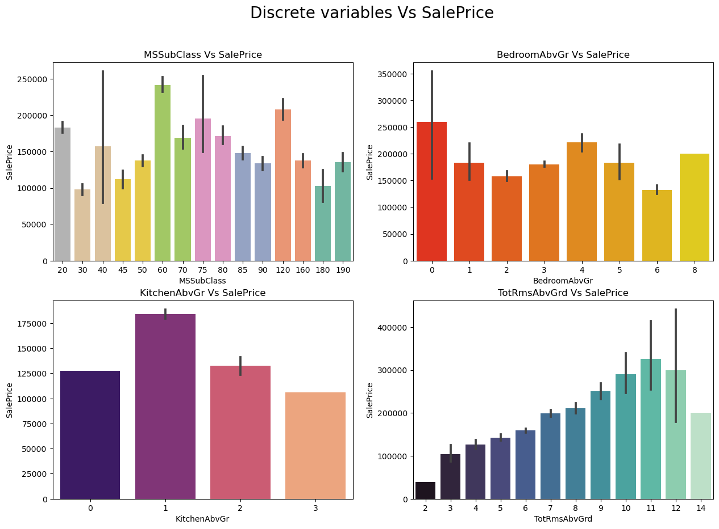
Visualizing Discrete Variables vs Sale Price

Slide 21
Observations:
SalePrice vs MSSubClass: The sale price is high for the MSSubClass 60,120 and 20.
SalePrice vs BedroomAbvGr: Many houses are having 0 and 4 bedrooms have high sales price also houses having 8 bedrooms also have high sales price. Other bedroom grades have average sale price.
SalePrice vs KitchenAbvGr: Most of the houses have single kitchen and few houses have 2 kitchens. The sale price is also high in case of the houses having single kitchen.
SalePrice vs TotRmsAbvGrd: We can observe some linear relation between Total rooms above grade and Sale Prices as the number of rooms increases the sales price also increases.

Slide 22
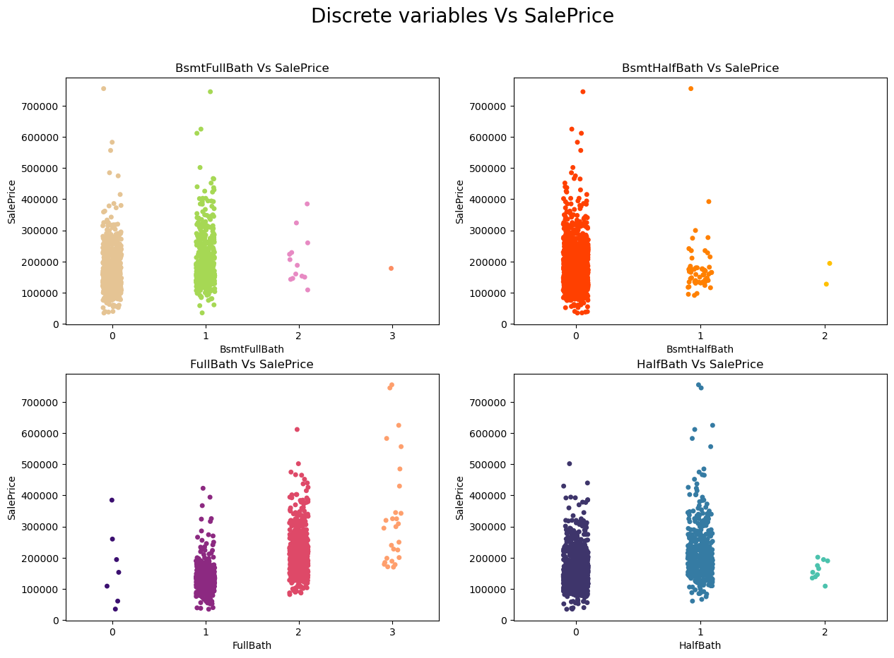
Visualizing Discrete Variables vs Sale Price

Slide 23
Observations:
SalesPrice vs BsmtFullBath: Most of the houses have basement full bathrooms as 0 and 1 which means some of the houses have single basement bathrooms and some of the houses have no basement bathrooms. And sales price is also high in these cases.
SalesPrice vs BsmtHalfBath: The houses do not have any single basement bathrooms and those houses have average sales price.
SalesPrice vs FullBath: There is positive linear relation between the sale price and full bathrooms above grade. Large number of houses have 1-2 full bathrooms. As the full bathrooms grades increases, sale price is also increasing slightly.
SalesPrice vs HalfBath: Some of the houses have no half bathrooms and also some of the houses have single half bathroom and very few houses have 2 half bathrooms. The houses with 0-1 half bathrooms have average sale price.

Slide 24
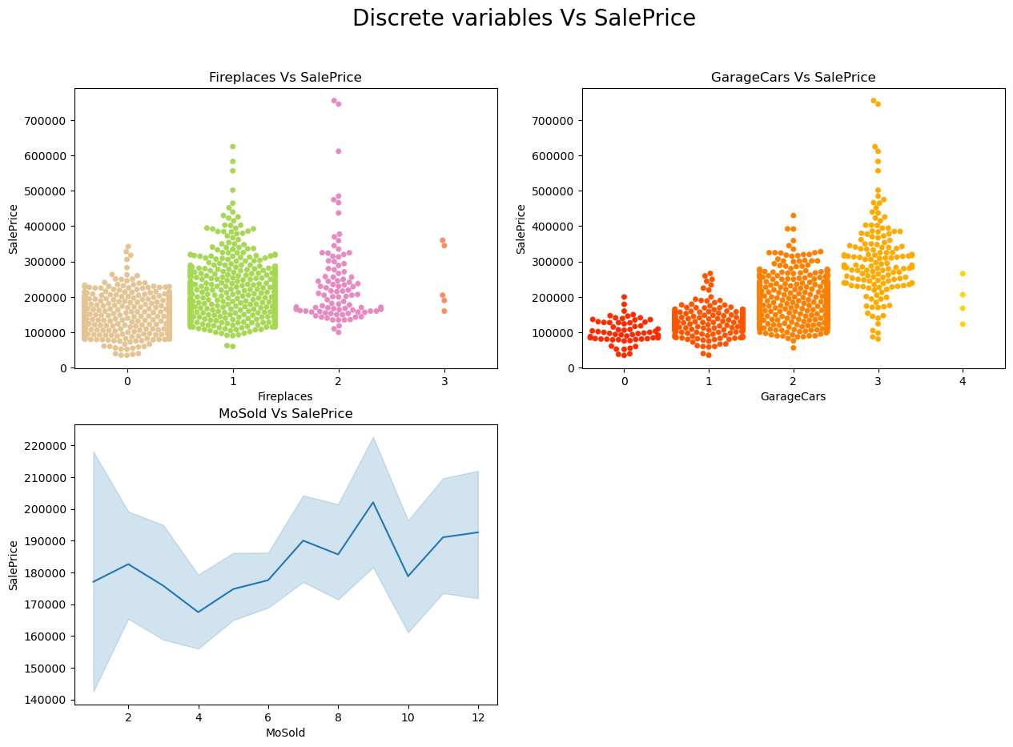
Visualizing Discrete Variables vs Sale Price

Slide 25
Observations:
SalesPrice vs Fireplaces: Some houses have no fire places and some houses have 1-2 fire places. The sales price is high for houses having single fireplaces.
SalesPrice vs GarageCars: There is positive linear relation between target and feature. As size of garage in car capacity increases, sales price also increases.
SalesPrice vs MoSold: Monthly sold have no significance impact on sale price.

Slide 26
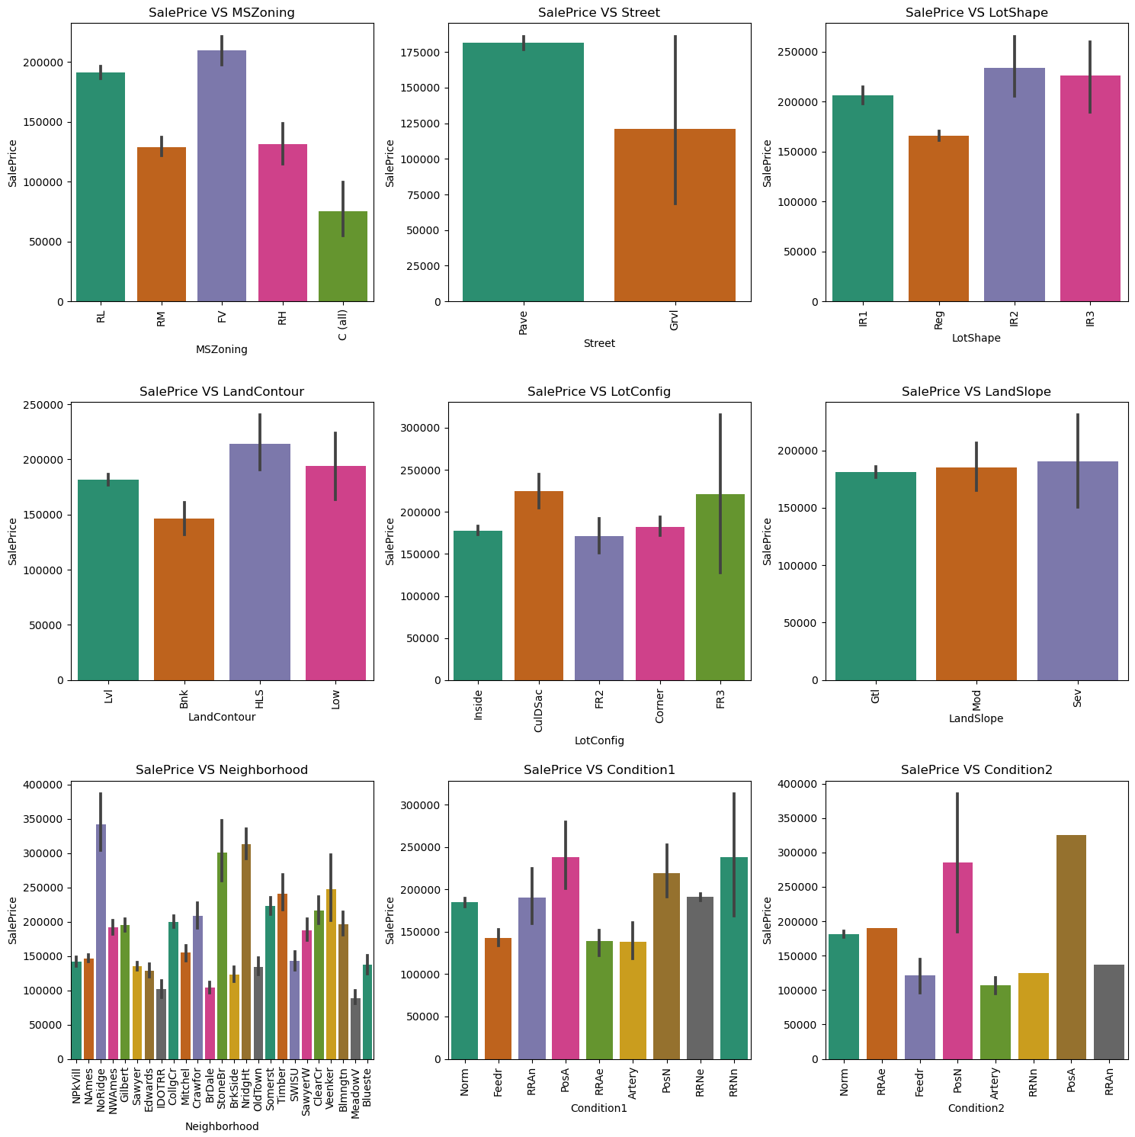
Visualizing Nominal Variables vs Sale Price

Slide 27
Observations:
SalePrice vs MSZoning: Most of the houses are belongs to Floating Village Residential followed by Residential Low Density. The houses from this zone are have high sale price compared to other zones.
SlaePrice vs Street: By observing the bar plot, it is obvious that the property of house with Paved type of road have high SalePrice and the the houses in gravel roads have very less sale price.
SlaePrice vs LotShape: Most of the houses having moderately irregular and irregular shape of property have high sale price and houses with regullar type of property have less sale peice compared to others.
SalePrice vs LandContour: The houses having the hillside and depression property flatness have high sale price compared to others.
SalePrice vs LotConfig: Most of the houses with Frontage on 3 sides of property have high sale price compared to others.
SalePrice vs LandSlope: There is no significance difference between the slope of the property. As we can observe the houses having Gentle slope, Moderate Slope and Severe Slope have same sale price.
SalePrice vs Neighborhood: The houses which are located near Northridge have high sale price compared to others.
SalePrice vs Condition1: The houses having the conditions adjacent to postive off-site feature and houses within 200' of North-South Railroad have high sale price compared to others.
SalePrice vs Condition2: The houses having the conditions near positive off-site feature park, greenbelt, etc and adjacent to postive off-site feature have high sale price.

Slide 28
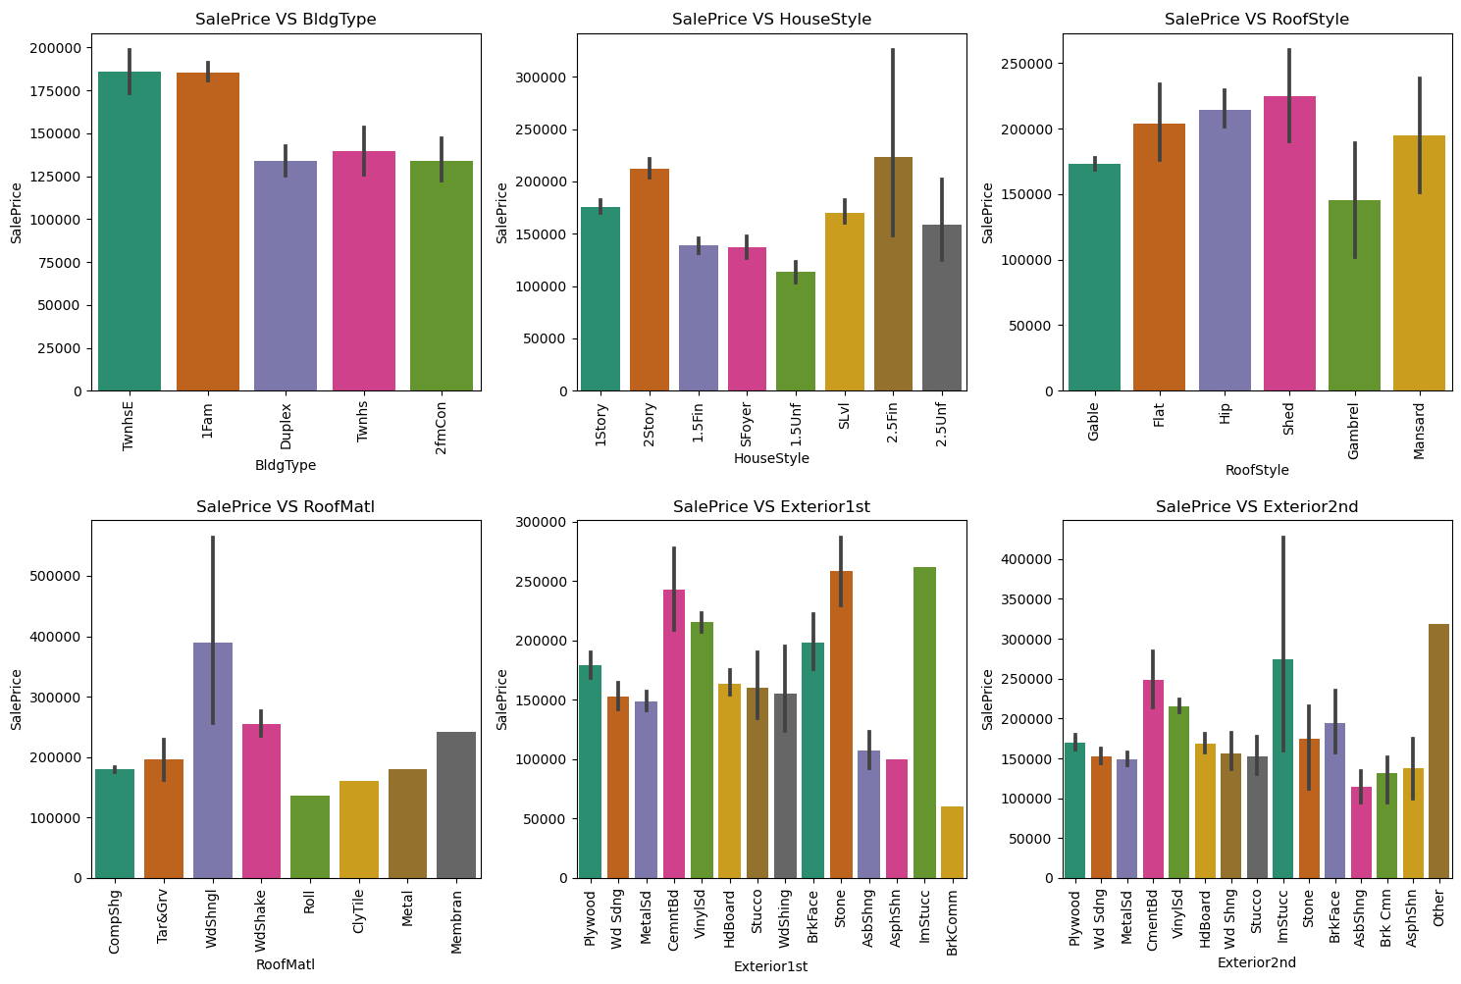
Visualizing Nominal Variables vs Sale Price

Slide 29
Observations:
SalePrice vs BldgType: Most of the houses are Single-family Detached and Townhouse End Unit and they have higher sale price compared to other categories.
SalePrice vs HouseStyle: Houses which are having style of dwelling 2nd level finished and Two story have high sale price compared to other types.
SalePrice vs RoofStyle: The houses having the roof style Flat, Hip and Shed have high sale price and the houses having gabrel roof style have less sale price.
SalePrice vs RoofMatl: Houses with Wood Shingles root materials have high sale prices.
SalePrice vs Exterior1st: Houses having Imitation Stucco, Stone and Cement Board as 1st exterior cover have high sale price.
SalePrice vs Exterior2nd: Houses having Imitation Stucco and other as 2nd cover have high sale price.

Slide 30
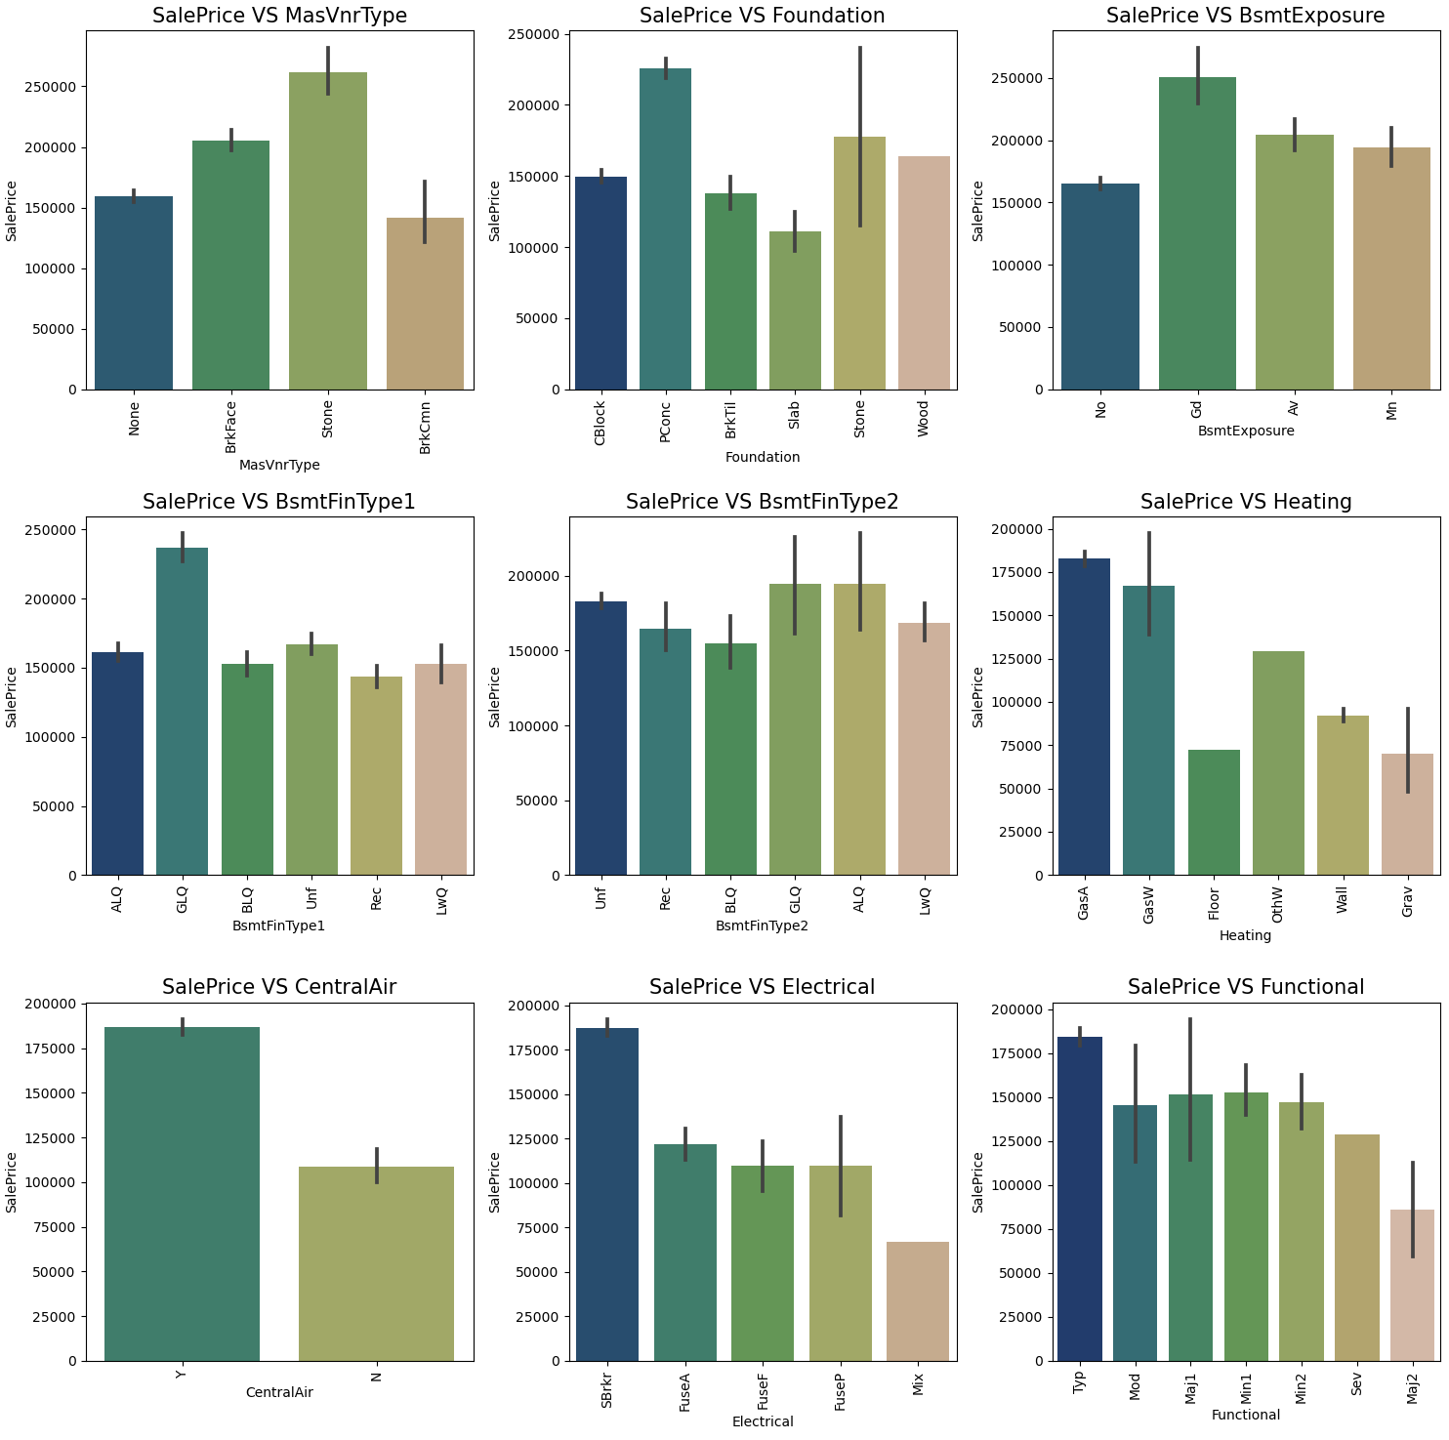
Visualizing Nominal Variables vs Sale Price

Slide 31
Observations:
SalePrice vs MasVnrType: Houses having Stone Masonry veneer type have high sale price than other types.
SalePrice vs Foundation: Houses having Poured Contrete as foundation type have high sale price compared to other types.
SalePrice vs BsmtExposure: Houses having good walkout or garden level walls have high sale price compared to others.
SalePrice vs BsmtFinType1: The sale price is high for the houses containing good living quarters basement finished area.
SalePrice vs BsmtFinType2: The sale price is moderately high for the houses having good living quarters and average living quarters.
SalePrice vs Heating: The houses having the heating type gas forced warm air furnace and gas hot water or steam heat have high sale price.
SalePrice vs CentralAir: Most of the houses have central air conditioning so it is obvious that these houses have high sale price.
SalePrice vs Electrical: Most of the houses having standard circuit breakers & romex have high sale price compared to others.
SalePrice vs Functional: The houses having the typical functionality have maximum sales price and others have average sale price.

Slide 32
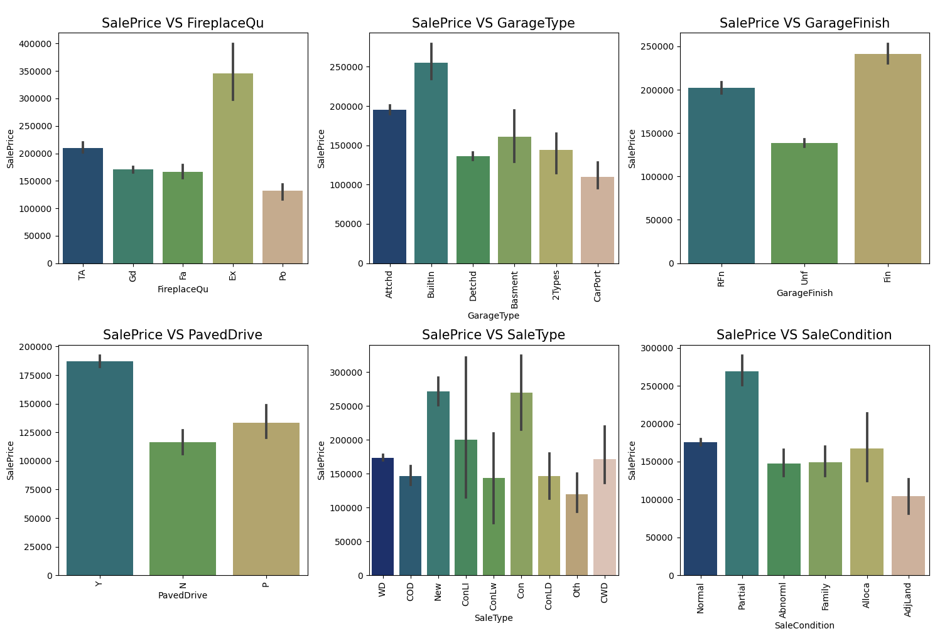
Visualizing Nominal Variables vs Sale Price

Slide 33
Observations:
SalePrice vs FireplaceQu: The houses having excellent exceptional masonry fireplace quality have high sale price and the houses having poor fireplace quality have very less sale price compared to others.
SalePrice vs GarageType: The houses having built-in garage have high sale price compared to others.
SalePrice vs GarageFinish: Garages located inside the house which is got finished have high sale price.
SalePrice vs PavedDrive: Houses having paved drive ways have high sale price.
SalePrice vs SaleType: Many houses having sale types as just constructed and sold and Contract 15% Down payment regular terms have high sale price.
SalePrice vs SaleCondition: Houses having partial sale condition that is home was not completed when last assessed have high sale price.

Slide 34
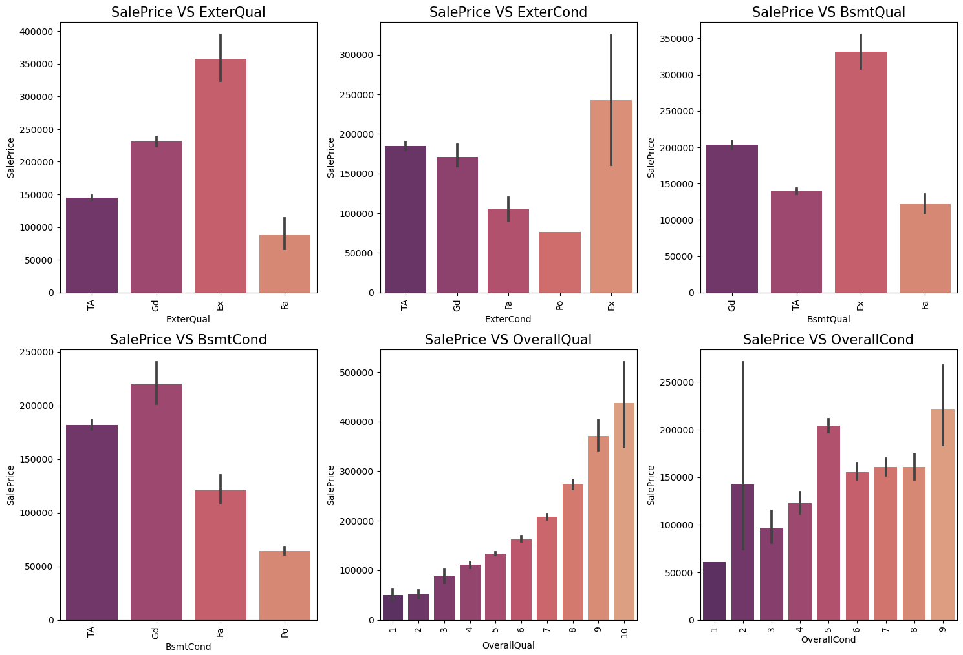
Visualizing Ordinal Variables vs Sale Price

Slide 35
Observations:
SalePrice vs ExterQual: Houses having excellent quality of the material on the exterior have high sale price and houses having fair quality have very less sale price.
SalePrice vs ExterCond: Houses having excellent condition of the material on the exterior have high sale price and the houses having poor condition of the material on the exterior have very less sale price compared to others.
SalePrice vs BsmtQual: The houses which evaluates the excellent quality of height of the basement have high sale price compared to others.
SalePrice vs BsmtCond: The houses which evaluates the good quality of general condition of the basement have high sale price compared to others.
SalePrice vs OverallQual: The houses which have very excellent overall quality like material and finish of the house have high sale price. Also we can observe from the plot as the overall quality of the house increases, the sale price also increases. That is there is good linear relation between SalePrice and OverallQual.
SalePrice vs OverallCond: The houses having overall condition as excellent and average have very high sale price compared to others.

Slide 36
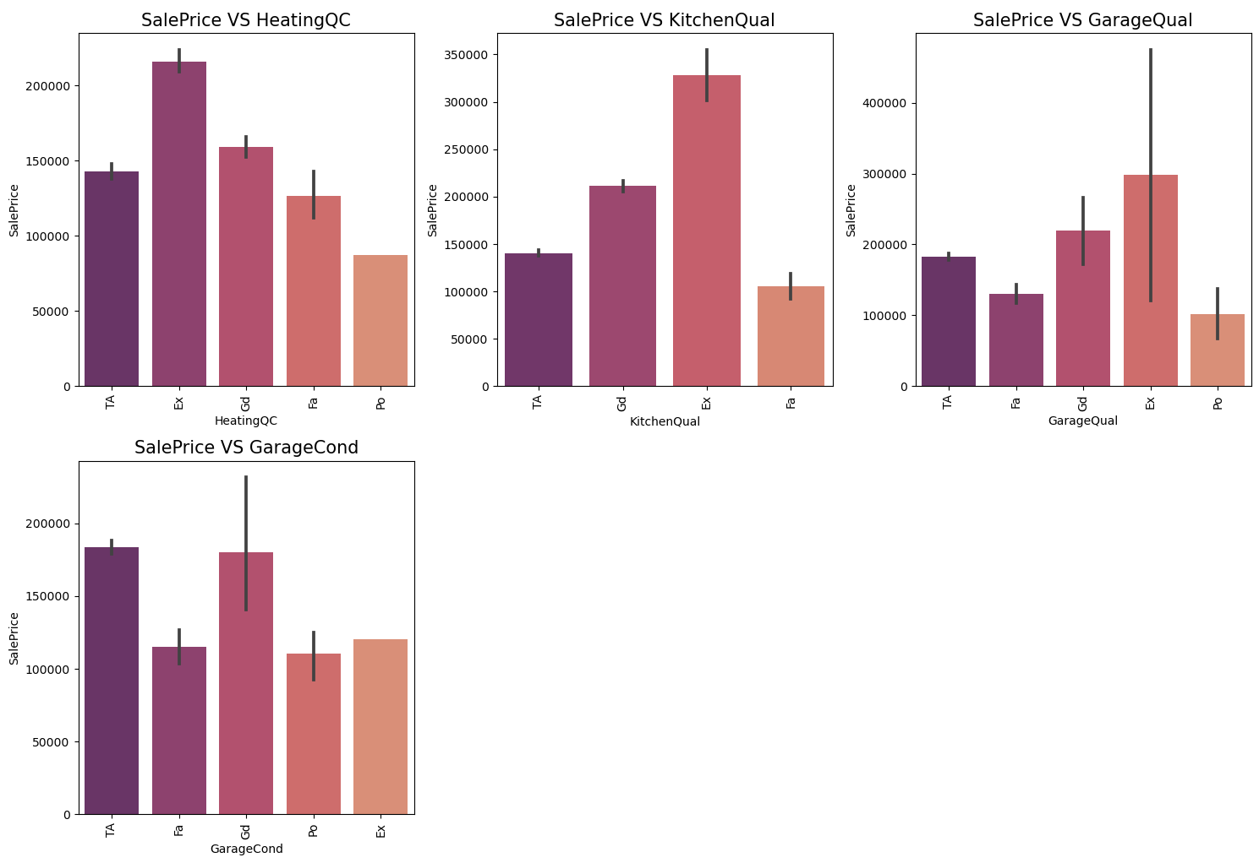
Visualizing Ordinal Variables vs Sale Price

Slide 37
Observations:
SalePrice vs HeatingQC: Most of the houses having excellent heating quality and condition have high sale price.
SalePrice vs KitchenQual: Houses having excellent quality of the kitchen have high sale price compared to others.
SalePrice vs GarageQual: The sale price of the house is high for the houses having excellent garage quality.
SalePrice vs GarageCond: Houses having typical/average garage condition have high sale price and the houses having good garage condition also have high sales price compared to others.

Slide 38
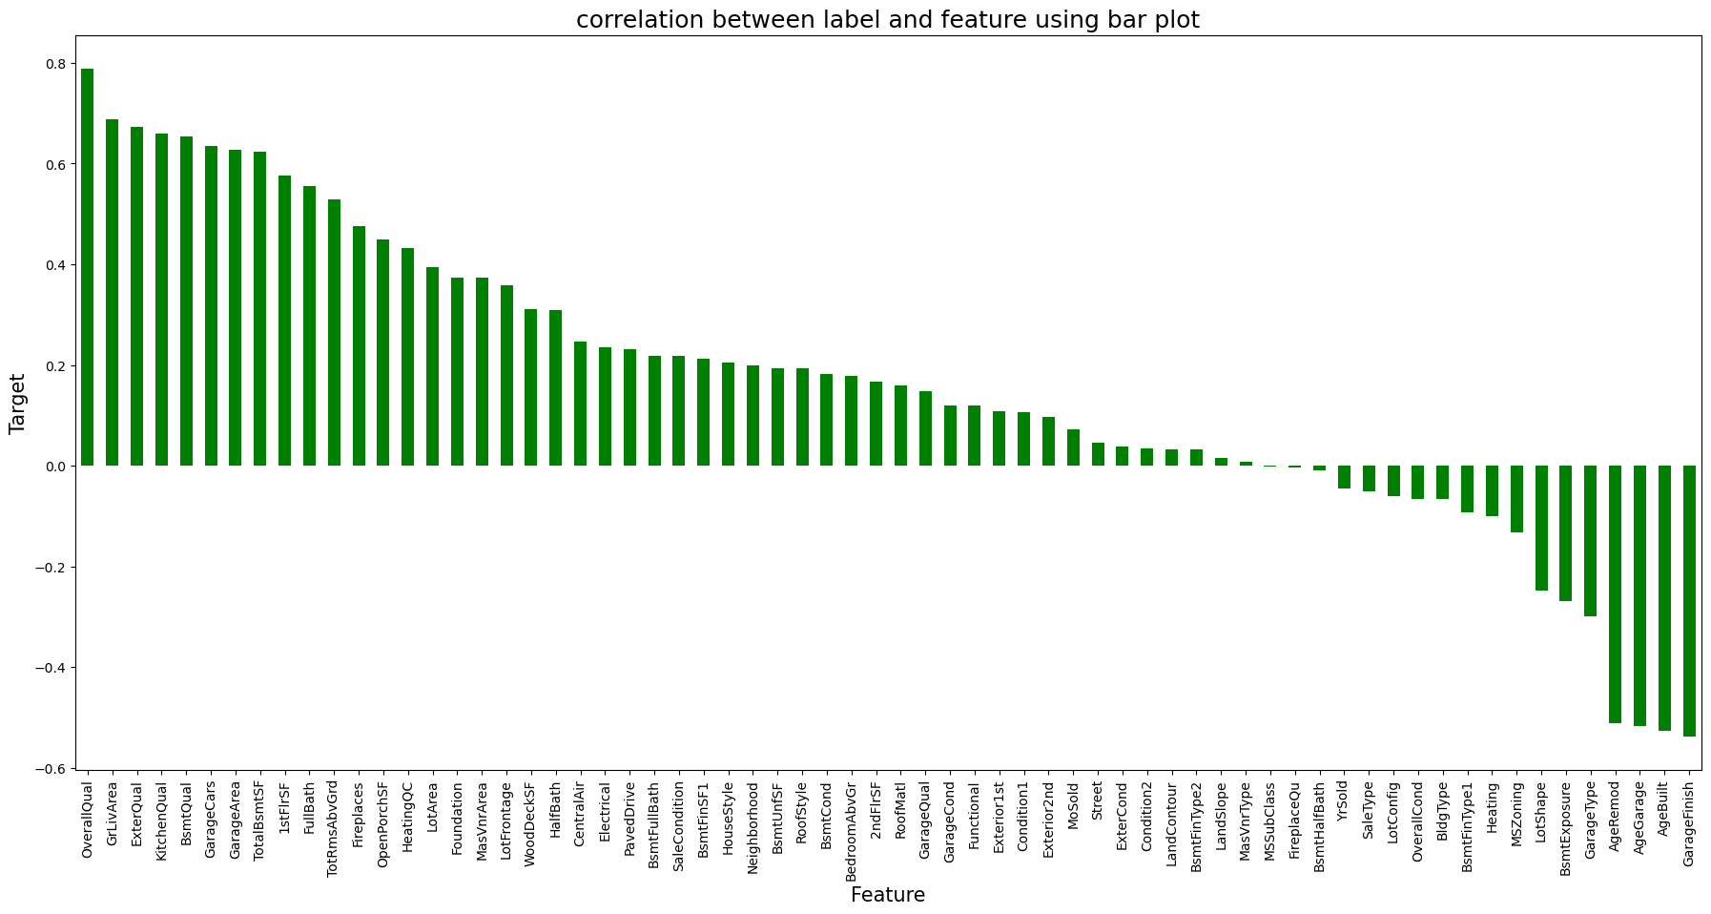
Correlation Between Features and Label
The bar plot shows the important features that affect Sale Price positively and negatively. We can easily notice the correlation here.

Slide 39
Data Analysis Steps done
I have treated null values by imputation techniques.
I have done feature engineering steps like feature extraction and feature selection to improve data normality and linearity.
Identified outliers using boxplots and removed outliers using percentile method.
Identified skewness using distribution plots and removed skewness using power transformation method (yeo-johnson method).
Encoded data using Ordinal Encoder.
Used Pearson’s correlation coefficient to check the correlation between dependent and independent variables. To visualize the correlation I have used heatmap and bar plot.
I have used Standard Scalarization method to scale the data.
Handled the multicollinearity issue by finding VIF values.
Split train and test to build machine learning models. Model building process will be shown in the further steps.

Slide 40
Assumptions:
Firstly, from the problem statement which states that it is a Regression type problem for which we will be using Regressor algorithms to build our models and predict the sale price of the house.
Secondly, based upon the analysis and visualization part we have seen some of the features having linear relation with label. So, I assumed these features helps in model building and to predict the sale price of the house. Also, these features play and important role as if someone planned to buy a house he/she can decide whether to buy house or not based on these features like environment, area, quality of the house etc.
So, I suggest that people take into consideration the features that were deemed as most important as seen in this study might help them estimate the house price better.

Slide 41
Model Building:
In this problem SalePrice is our target variable which is continuous in nature, from this I can conclude that it is a regression type problem hence I have used following regression algorithms to predict the sale price of the house.
After the pre-processing and data cleaning I left with 67 columns including target and I used these features for prediction.
Linear Regression
Lasso Regressor
Ridge Regressor
Random Forest Regressor
Extra Trees Regressor
Gradient Boosting Regressor
Extreme Gradient Boosting Regressor (XGB)
Bagging Regressor
I have got the best ransom state and maximum R2 score and then created train test split to build the above models.

Slide 42
I. Linear Regression:
Created linear regression model and getting 84.51% R2 score using this model. From the reg plot I can observe the sales price of the house. The best fit line shows there is strong linear relation between test data of trained model and predicted values.

Slide 43
II. Lasso Regressor (Regularization):
I have got the alpha value as 100, the parameter ‘alpha’ which controls the regularization of the model.
Created Lasso regressor model and getting 84.82% R2 score using this model. From the reg plot I can observe the sales price of the house. The best fit line shows there is strong linear relation between test data of trained model and predicted sale price.

Slide 44
III. Ridge Regressor (Regularization):
I have got alpha value as 100 using this I have created Ridge regressor model and getting 85.14% R2 score using this model. From the plot I can observe the sales price of the house. The best fit line shows there is strong linear relation between test data of trained model and predicted sale price.

Slide 45
IV. Random Forest Regressor:
Created Random Forest Regressor model and getting 89.86% R2 score using this model.

Slide 46
V. Extra Trees Regressor:
I have created Extra Trees Regressor model and getting 89.03% R2 score using this model.

Slide 47
VI. Gradient Boosting Regressor:
Created Gradient Boosting Regressor model and getting 90.04% R2 score using this model

Slide 48
VII. Extreme Gradient Boosting Regressor (XGB):
Created Extreme Gradient Boosting Regressor model and getting 87.83% R2 score using this model.

Slide 49
VIII. Bagging Regressor:
Created Bagging Regressor model and getting 88.68% R2 score using this model.

Slide 50
Model Selection:
From the difference between R2 score and Cross Validation score I can conclude that
XGB Regressor as my best fitting model as it is giving less difference compare to other models.
Let's perform Hyperparameter tuning to increase the model accuracy.

Slide 51
Hyper Parameter Tuning
I have used GridSearchCV to get the best parameters of XGB Regressor. And used all the obtained parameters to get the accuracy of final model.

Slide 52
Creating Final Model After Tuning:
The R2 score of XGB Regressor has been increased 2% after tuning the model. It is giving R2 score as 89.95% which is very good. The plot gives some strong linear between test and predicted values. Also, I can notice the MAE, MSE and RMSE values have been reduced. Which means the our model trained well.

Slide 53
Conclusion:
In this study, we have used multiple machine learning models to predict the house sale price. We have gone through the data analysis by performing feature engineering, finding the relation between features and label through visualizations. And got the important feature and we used these features as inputs to predict the price by building ML models.
We have got good prediction results. After using hyper parameter tuning, the best model increased by 2% and the R2 score was 89.95% also the errors decreased which means no over-fitting issue. And predicted the sale price for test data using saved best model.
Finally, our aim is achieved by predicting the house price for the test data, I hope this will be further helps for sellers and buyers to understand the house marketing. The machine learning models and data analytic techniques will have an important role to play in this type of problems. It helps the customers to know the future price of the houses.
As a recommendation, I advise to use this model by the people who want to buy a house in the area covered by the dataset to have an idea about the actual price. The model can be used also with datasets that cover different cities and areas provided that they contain the same features. I also suggest that people take into consideration the features that were deemed as most important as seen in this study might help them estimate the house price better.

Slide 54
Thank You

